Slide 1


Slide 2
NAMES: RUKUNDO Jeannine
REG NUMBER: 25RP18144

Slide 3
Water Potability Prediction Using Machine Learning

Slide 4
PROBLEM STATEMENT
Problem: Predicting Water Potability Based on Water Quality Parameters
Importance: Access to safe drinking water is a fundamental human right and critical for public health. Contaminated water causes numerous waterborne diseases affecting millions globally. An automated system that can predict water potability from basic chemical and physical measurements can help:
Enable rapid water quality assessment in remote areas
Reduce laboratory testing costs and time
Support early warning systems for water contamination
Aid in water treatment process optimization

Slide 5
Dataset Description
Dataset: Water Potability Classification Dataset
Source: Provided dataset (typical of water quality datasets from Kaggle/UCI)
Size: 3,276 samples with 10 features
Features:
ph: pH value of water
Hardness: Water hardness capacity
Solids: Total dissolved solids
Chloramines: Chloramines content
Sulfate: Sulfate concentration
Conductivity: Electrical conductivity
Organic_carbon: Organic carbon content
Trihalomethanes: Trihalomethanes concentration
Turbidity: Water turbidity
Target: Potability (0 = Not potable, 1 = Potable)

Slide 6
EDA Findings
Missing Values: ph, Sulfate, and Trihalomethanes have significant missing values
Class Imbalance: Approximately 61% non-potable vs 39% potable
Outliers: Present in several features like Solids and Conductivity
Correlations: Weak correlations between features, suggesting independence

Slide 7
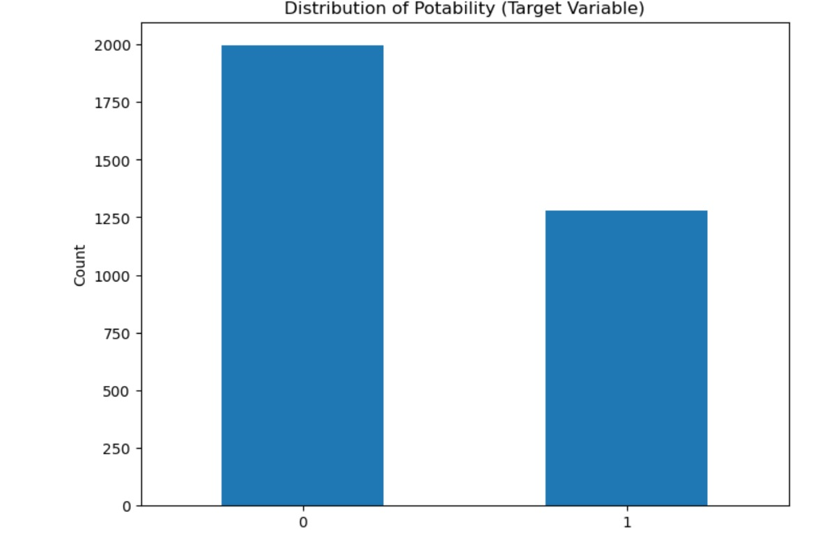
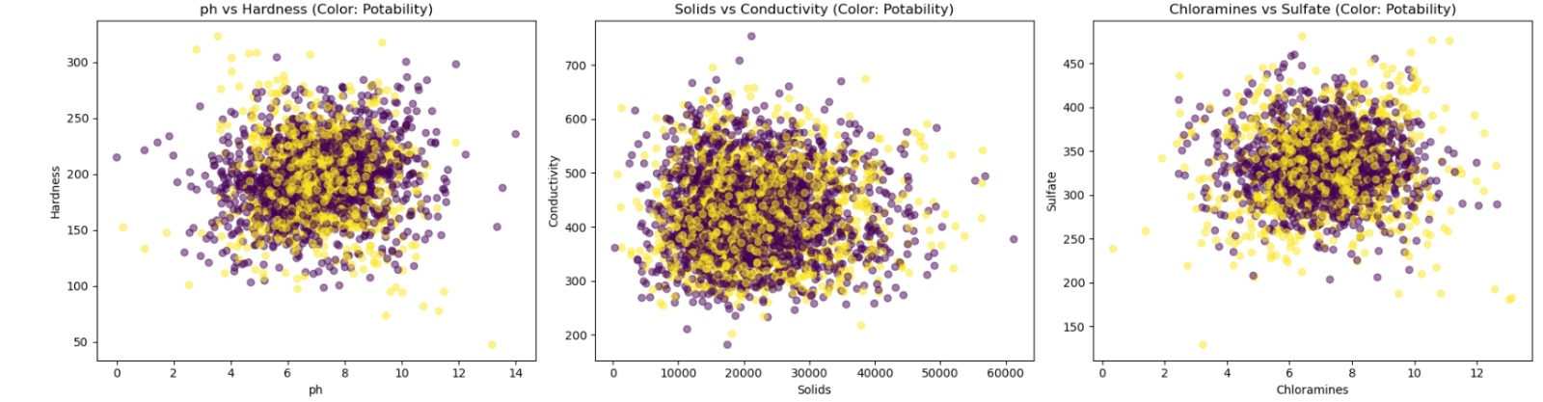
EDA Findings
Bar chart
Scatter plot

Slide 8
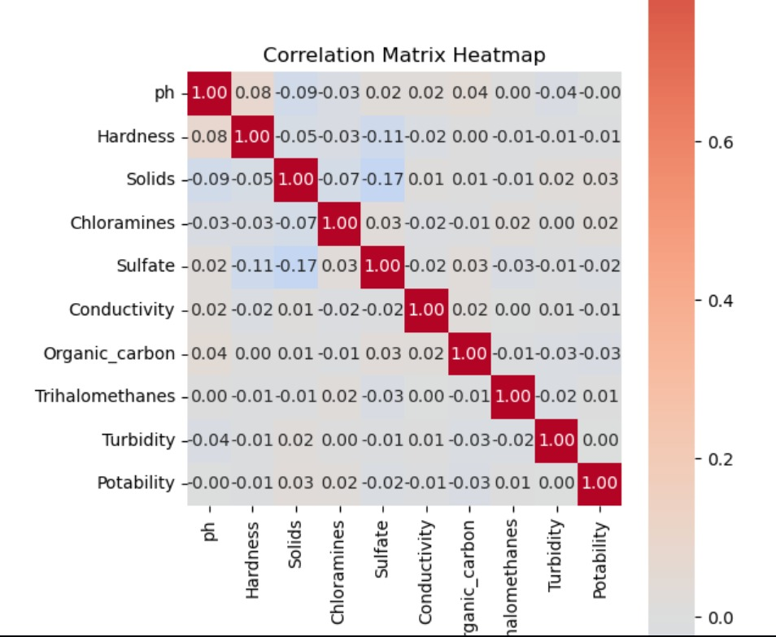
Correlation matrix

Slide 9
Feature engineering steps applied and justification
Step | Technique | Purpose | Impact
1 | Missing Value Imputation | Handle incomplete data | Prevent model errors
2 | Outlier Treatment | Reduce noise in data | Improve model stability
3 | Feature Scaling | Normalize feature ranges | Enhance algorithm performance
4 | Feature Extraction | Reduce dimensionality | Speed up training

Slide 10
Role of scatter plot
In the Water Potability project, scatter plots help visualize relationships between features, identify patterns, detect outliers, and assess how well features separate potable from non-potable water, aiding in better data understanding and model improvement.

Slide 11
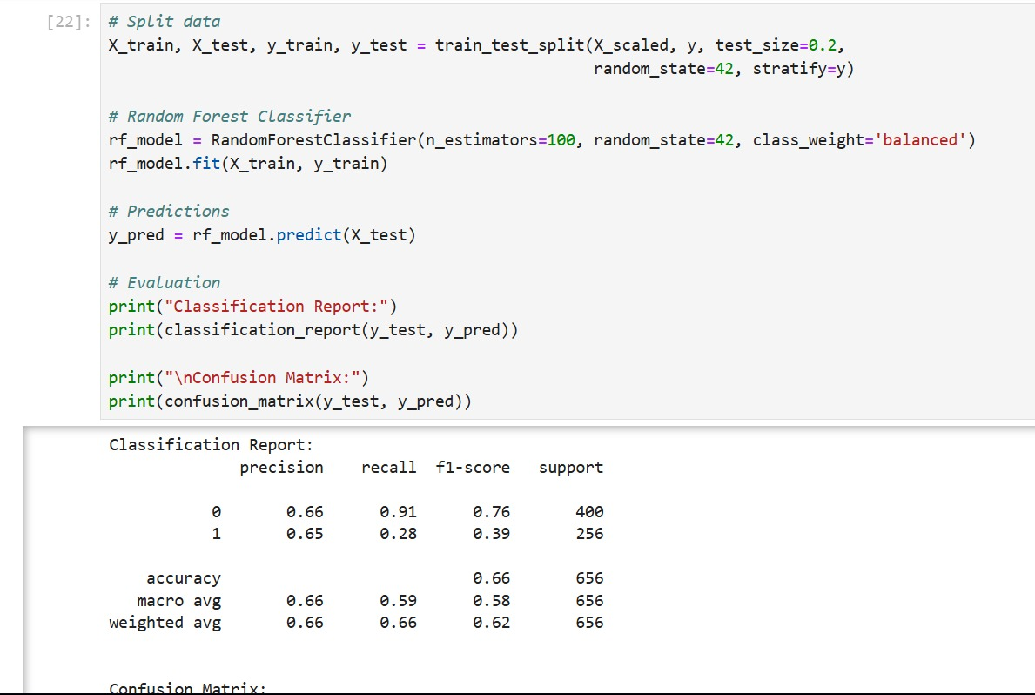
Model building and evaluation process

Slide 12
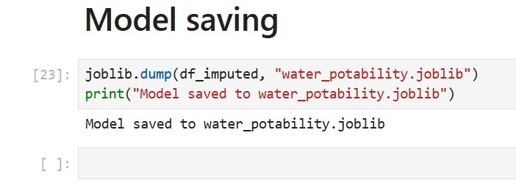
Saving model

Slide 13
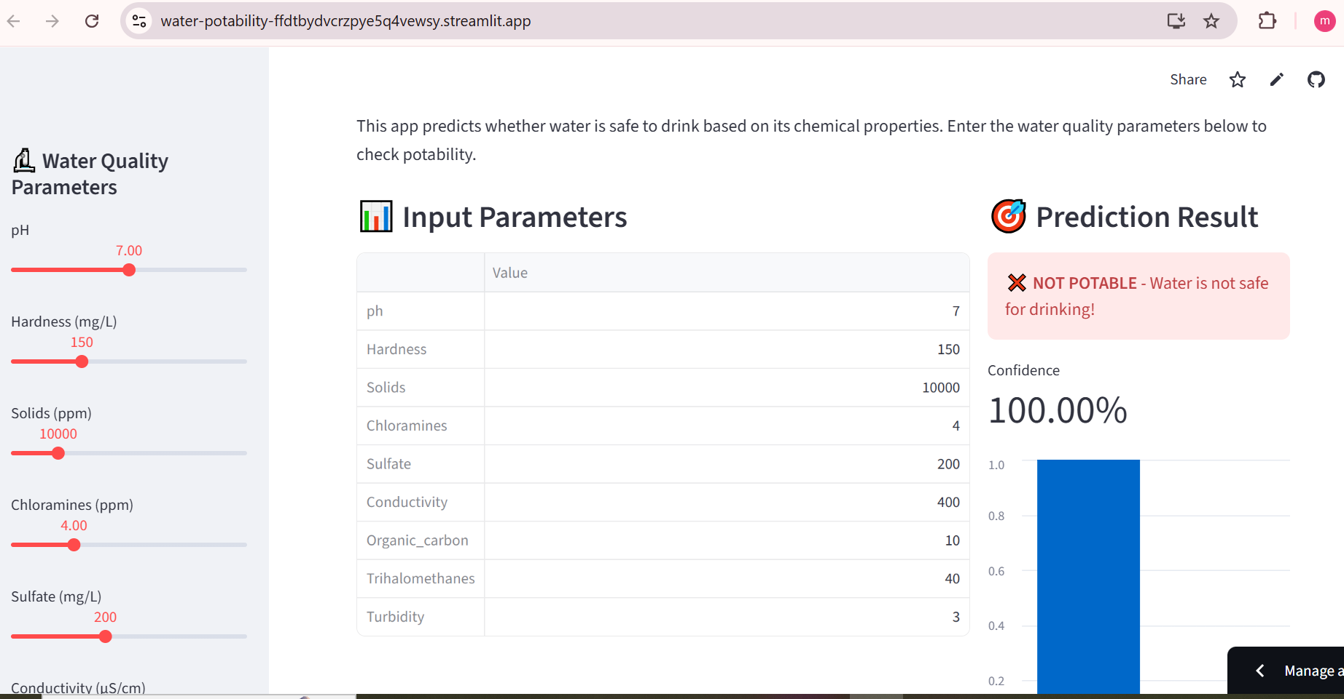
Model deployment
This result clearly shows that the entered water parameters are unsafe, with the model predicting "NOT POTABLE" with 100% confidence.

Slide 14
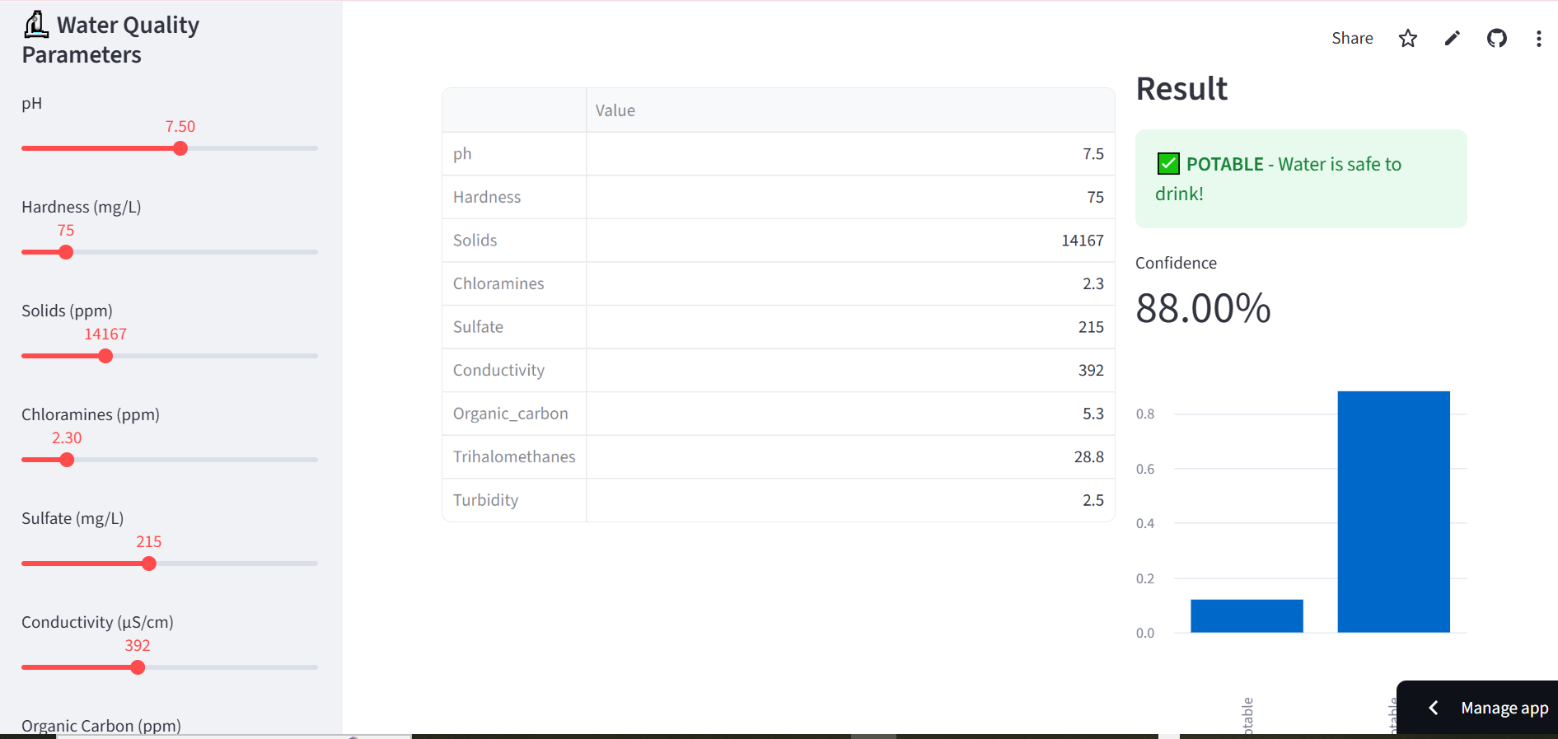
Model deployment
This output shows a positive potability check, confirming the water is safe for 88% confidence.

Slide 15
Thank you!!!!

